Slide 1
Sequences
Intro, Arithmetic Sequences

Slide 2
Today you will …
Learn how to write rules for sequences
Identify and find rules for arithmetic sequences
Practice using English to describe math processes and equations

Slide 3
A Sequence
It’s okay to repeat numbers! $2, 1, 2$ is a valid sequence
An ordered list of numbers
Sequences can be finite …
or infinite …
Order matters! $1, 2, 3$ is not the same as $2, 1, 3$
Each term has an index (place in sequence)
1 2 3 4 5 6 7 …
$$1, 4, 7, 10, 13, 16, 19$$
$$, .. .$$
Terms of the sequence (sometimes called elements)

Slide 4

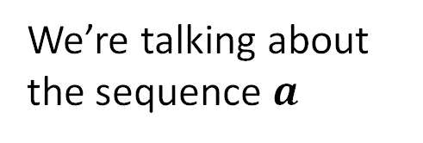
Subscripts
$$a=1, 4, 7, 10, 13, 16, 19$$
We’re talking about the sequence $a$
The subscript says we want element $3$
$$a_{3}=7$$
The third element is $7$
What is $a_{5}$ in the sequence above?

Slide 5
Sequences are Functions
$$a=1, 4, 7, 10, 13, 16, 19$$
Input – domain … the indices
$$n$$ | 1 | 2 | 3 | 4 | 5 | 6 | 7
$$f(n)$$ | 1 | 4 | 7 | 10 | 13 | 16 | 19
Output – range … the terms

Slide 6

“Rules”
How do you describe a particular sequence?
$$1, 4, 7, 10, 13, 16, 19$$
…let’s build one for this sequence…
The first term is $1$
Each term is the previous term plus 3
What happens if I keep going?
I can simplify
$$a_{1}=1$$
$$a_{n}=a_{n−1}+3$$
$$a_{n}=1+3+3+…+3$$
$$a_{n}=1+\left(n−1\right)3$$
n terms total…
so have (n-1) 3’s…

Slide 7

Finding Rules
+5
+5
+5
Find a rule for the sequence $3, 8, 13, 18$
$$a_{1}=$$
$$a_{n}=a_{n−1}+5$$
$$a_{n}=3+5+5+5+…+5$$
$$a_{n}=3+5(n−1)$$
$$3$$
$$5$$
$$3+5+5+5+…+5$$
$$3+5(n−1)$$

Slide 8
Arithmetic Sequences
Rule: the difference between each consecutive term is constant
The difference is called the common difference denoted $d$
$$1, 4, 7, 10, 13, 16, 19$$
+3
+3
+3
+3
+3
+3
In this example, the common difference is 3

Slide 9
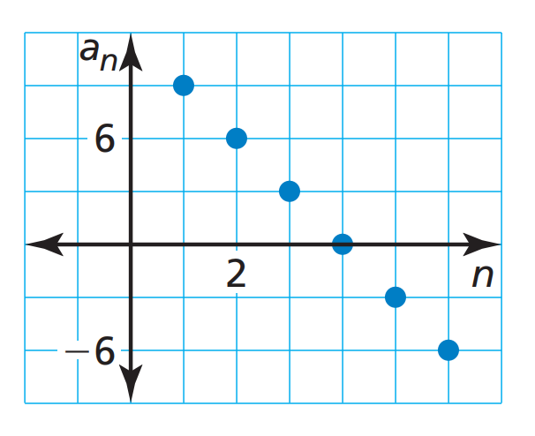

Rules for Arithmetic Sequences
Recursively:
$$a_{1}=…$$
$$a_{n}=a_{n−1}+d$$
Explicitly:
$$a_{n}=a_{1}+\left(n−1\right)d$$
Arithmetic sequences are linear

Slide 10

Finding Rule from Terms
Find a rule for the sequence $55, 47, 39, 31$
$$a_{1}=55$$
$$a_{n}=a_{n−1}−8$$
$$a_{n}=55−8−8−8−8−…−8$$
$$a_{n}=55+(n−1)(−8)$$

Slide 11
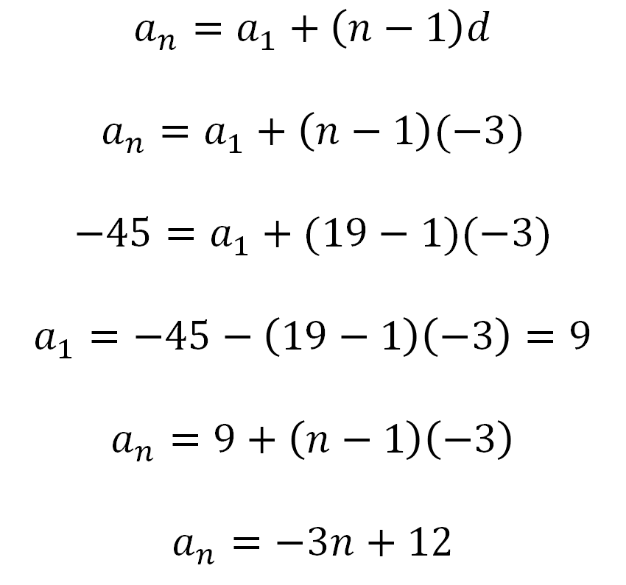
Rule from Term and a Common Difference
One term of an arithmetic sequence is $a_{19}=−45$.
The common difference is $d=−3$.
Write a rule for the $n^{th}$ term
$$a_{n}=a_{1}+\left(n−1\right)d$$
$$a_{n}=a_{1}+\left(n−1\right)(−3)$$
$$−45=a_{1}+(19−1)(−3)$$
$$a_{1}=−45−\left(19−1\right)\left(−3\right)=9$$
$$a_{n}=9+\left(n−1\right)\left(−3\right)$$
$$a_{n}=−3n+12$$

Slide 12
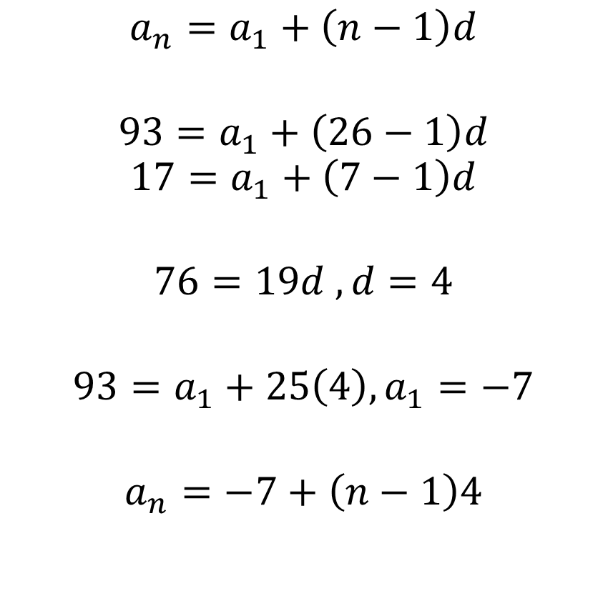
Rule from Two Terms
Two terms of an arithmetic sequence are $a_{7}=17$ and $a_{26}=93$.
Write a rule for the $n^{th}$ term.
$$a_{n}=a_{1}+\left(n−1\right)d$$
$$93=a_{1}+\left(26−1\right)d$$
$$17=a_{1}+\left(7−1\right)d$$
$$76=19d , d=4$$
$$93=a_{1}+25\left(4\right), a_{1}=−7$$
$$a_{n}=−7+\left(n−1\right)4$$
-(
a system of equations!
)
$$a_{n}=4n−11$$

Slide 13
Homework
414 #5,7,9,11,15,16,20,21,23
422 #4,6,8,10,14,16,18

